Slide 1
Lab-3
Build Logistic Regression Model for a given dataset

Slide 2
Logistic Regression
Logistic Regression for Binary Classification
Logistic Regression for Multiclass Classification

Slide 3
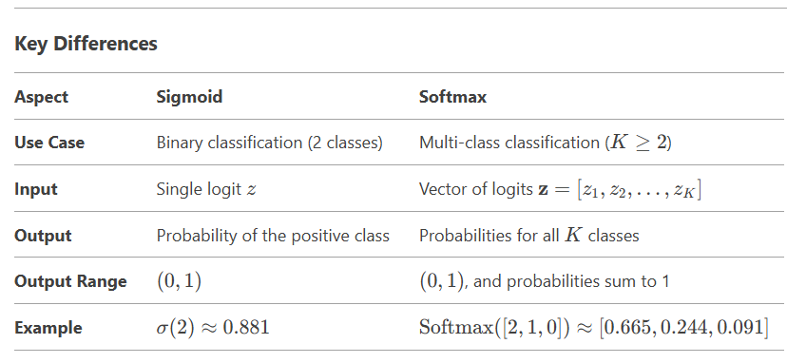
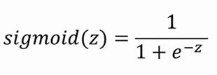

Sigmoid vs Softmax Activation function
Sigmoid: Used for binary classification. Maps a single logit to a probability.
Softmax: Used for multi-class classification. Maps a vector of logits to probabilities for all classes.

Slide 4
To write in Observation Book
1. Consider a binary classification problem where we want to predict whether a student will pass or fail based on their study hours. The logistic regression model has been trained, and the learned parameters are a0=−5 (intercept) and a1=0.8 (coefficient for study hours).
a. Write the logistic regression equation for this problem.
b. Calculate the probability that a student who studies for 7 hours will pass.
c. Determine the predicted class (pass or fail) for this student based on a threshold of 0.5.
2. Consider z=[2,1,0] for three classes. Apply SoftMax function to find the probability values of three classes.

Slide 5
Confusion Matrix
In the field of machine learning, a confusion matrix is a specific table layout that allows visualization of the performance of an algorithm.
A confusion matrix contains information about actual and predicted classifications done by a classification system.
 | Predicted Class
Actual Class | True Positive | False Negative
 | False Positive | True Negative
Correct Classification
Incorrect Classification
Notes:
In the field of machine learning, a confusion matrix is a specific table layout that allows visualization of the performance of an algorithm, typically a supervised learning one (in unsupervised learning it is usually called a matching matrix). Each column of the matrix represents the instances in a predicted class, while each row represents the instances in an actual class. The name stems from the fact that it makes it easy to see if the system is confusing two classes (i.e. commonly mislabeling one as another).
In my decision tree (J48) classifier output, there is a confusion Matrix
a b <----- classified as
130 8 a = functional
15 150 b = non-functional
The row indicates the true class, the column indicates the classifier output. Each entry, then, gives the number of instances of that were classified as . In your example, 15 Bs were (incorrectly) classified as As, 150 Bs were correctly classified as Bs, etc.
As a result, all correct classifications are on the top-left to bottom-right diagonal. Everything off that diagonal is an incorrect classification of some sort.

Slide 6
Confusion Matrix - Example
 |  | Predicted Class
 |  | Cat | Dog
Actual Class | Cat | 5 True Positives (actual cats that were correctly classified as cats) | 3 False Negatives (cats that were incorrectly marked as dogs)
 | Dog | 2 False Positives (dogs that were incorrectly labeled as cats) | 3 True Negatives (actual dogs that were correctly classified as dogs)
Correct Classification
Incorrect Classification
In this confusion matrix,
of the 8 actual cats, the system predicted that three were dogs,
and of the five dogs, it predicted that two were cats.
Notes:
In this confusion matrix, of the 8 actual cats, the system predicted that three were dogs, and of the five dogs, it predicted that two were cats.

Slide 7
Implementation
In your Google Co-lab account, execute following sample python program in the notebook.
LogisticRegression_Binary.py
LogisticRegression_Multiclass.py

Slide 8
To Do: Implementation – Logistic Regression (Binary Classification)
Write Python code to implement the following. Consider dataset file as “HR_comma_sep.csv”
Do some exploratory data analysis to figure out which variables have direct and clear impact on employee retention (i.e. whether they leave the company or continue to work)
Plot bar charts showing impact of employee salaries on retention
Plot bar charts showing corelation between department and employee retention
Build logistic regression model using variables that were narrowed down in step 1
Measure the accuracy of the model

Slide 9
To Do: Implementation – Logistic Regression (Multiclass Classification)
Write Python code to implement the following. Consider dataset file “zoo-data.csv” to predi . Details of class type is provided in “zoo-class_type .csv”
If require apply necessary data preprocessing.
Build logistic regression model to predict “class_type”
Measure the accuracy of the model
Plot the confusion matrix

Slide 10
To Upload to Github
In your github account create folder “6thSem-ML-Lab” and upload your python notebook worked on Linear and Multi Linear regression modelss with file name as “yourUSN_Lab-3-Logistic-Regression. ipynb”

Slide 11
To write in the Observation Book
After building the Logistic regression models, write the answer for the following questions in your observation book
1. For dataset file “HR_comma_sep.csv”
i. Which variables did you identify as having a direct and clear impact on employee retention? Why?
ii. What was the accuracy of your logistic regression model? Do you think this is a good accuracy? Why or why not?
2. For Zoo dataset
i. Did you perform any data preprocessing steps? If yes, what were they, and why were they necessary?
ii. Were there any missing or inconsistent values in the dataset? How did you handle them?
iii. What does the confusion matrix tell you about the performance of your model?
iv. Which class types were most frequently misclassified? Why do you think this happened?

